Slide 1
Machine Learning for Handwritten digit recognition in Warehousing By Richa Singh

Slide 2
MNIST Dataset
Number of instances :70,000 images.
Number of attributes : 784(28X28 pixels)
Target Column(Class) – Represents the digit (0- 9) corresponding to the handwritten image.
Pixel (1 to 784) – Each pixel value (0 - 255), display the grayscale magnitude of the corresponding pixel in the image.
Sets - Training set have 60,000 images and Test set have 10,000.

Slide 3
Extracting and Reshaping
X represents the MNIST dataset ,where each row corresponds to a flattened 28x28 pixel image of handwritten digit.
to_numpy() method is used to convert the dataset X into a Numpy array.
Slicing method is used to extract label data and assign it to the variable y.

Slide 4
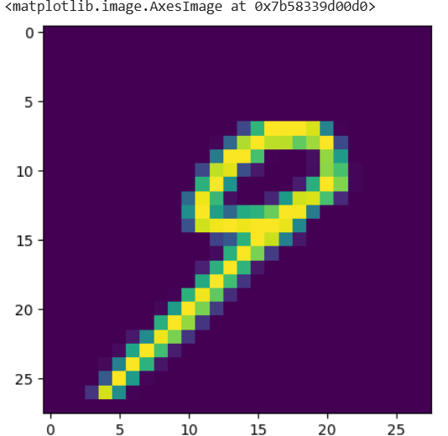
Visualization
I have applied .reshape to prepare the image for visualization and further analysis.
Reshaping is done to transform data structures for better analysis.

Slide 5
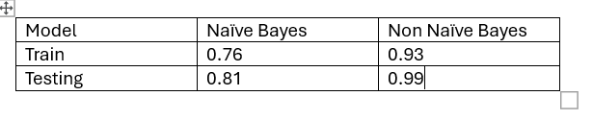
Model Comparison Accuracy

Slide 6
Advantage of Non-NaiveBayes
Improved Performance with Continuous Data
Handling Feature Dependencies.
Higher predictive Accuracy.
Improved Robustness to Noise

Slide 7
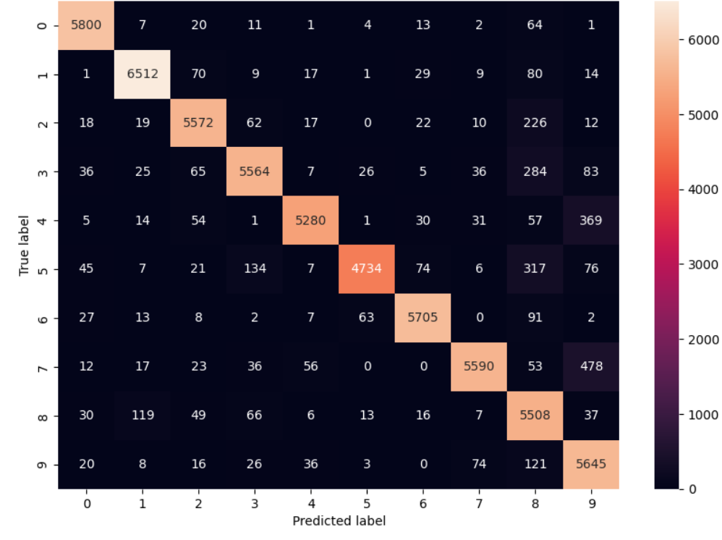
Predicted class are correlated to true class. It shows how many prediction are correct and incorrect per class. It helps in understanding the classes that are being confused by model as other class
Correlation Matrix

Slide 8

Use case of Product Warehouse
Warehouse Analogy : In warehouses where camera, sensors and manual effort are used to record categories, materials, labels, barcode, packaging etc of the products delivered. The dataset which we are going to build will use the recorded data to identity target label and features. The dataset will be used to train, test and predict product category for any unseen data.

Slide 9
Problem Definition
Objective: identify the category of the products coming to the warehouse.
Input Data:Manual effort are used to record categories, materials, labels, barcode, packaging etc of the products delivered.
Output Data: Predict the category for any unseen data..

Slide 10
Data Collection
Gather text related data in the warehouse environment, like :
Barcode text
Shipping Invoices
Inventory logs
Product ID
Product Status
Product Condition
Product Description
Material
Weight
Unit – each, kg, ml etc

Slide 11
Text Preprocessing
Convert all text to lowercase
Remove handwritten punctuation marks and any unwanted characters.
Breaking down the text into words or phrases.
Eliminate common words that do not contribute to the classification.
Use label encoding to represent text in a numeric format.

Slide 12
Feature Extraction
Transform the pre-processed text into numerical form that a Non-Navies Bayes can understand by encoding the data.
We can treat each text as a matrix where each row is a document, and each column correlated to a word in the collection.

Slide 13
Example Dataset for Warehouse
X (Features)
Text extracted from:
Sensor data, such as weight, size, or dimensions of the material.
Image data of the material (e.g., labels, packaging, or material itself).
Manually added data
Text will be transformed into numerical values
Y (target variables):
Represents the product category that the system is trying to predict or classify. For instance, - Categories like clothing, furniture or fragile

Slide 14

Conclusion
Studied MSINT dataset and its prediction model.
Applied the dataset representation on product warehouse dataset by identifying product category as target label and other manually recorded data like material , description as features
Represented text data into digits using label encoding
Split the data into training and test data
Trained the model and predict the label.
Just as in MNIST, where a model learns to map images to digits (e.g., predicting a 7 for an image of the digit "7"), the model in the product warehouse scenario will learn to map text to digits

Slide 15
Thankyou

